Slide 1
VIT Event Registration Portal
Nikhil Saju - 19BCE0655
Anirudh Saxena - 19BCE2449
Sriyashree Padhy - 19BCE2356
B Ashwin Janardhan - 19BCE2443

Slide 2
Abstract
Our team is building an web application that gives a detailed view on all the events/workshops that are help by VIT clubs and chapters.
This has 2 login options: event host and user.
Users can register for any event that is listed. They can view all details, filter, search and also provide preferred types.
Event hosts get the functionalities like add/remove/edit event and event details, see the list of participants for a particular event, etc.

Slide 3
Problem Statement
Vit Vellore , the eminent Indian institution hosts some of the best known student festivals and events in the country, attracting people in immense numbers . However the current portal for registering for these events is slow , often laggy , glitches out and has other issues . Therefore the requirement of a portal dedicated for registration for VIT based events which is better, more responsive and solves the discrepancies of the existing portal seems necessary

Slide 4
Reason for choosing this topic
Lack of a proper, dedicated web application for event registration. In our website, we provide all the information in an organized manner and with various search/filter options.
Students can get a detailed view on the events and workshops conducted by the various clubs/chapters of VIT, as well as an easy one-click registration for the same.
The website allows students to see all the events/workshops (with all details) conducted in one place so that they do not miss out on events that interests them.

Slide 5
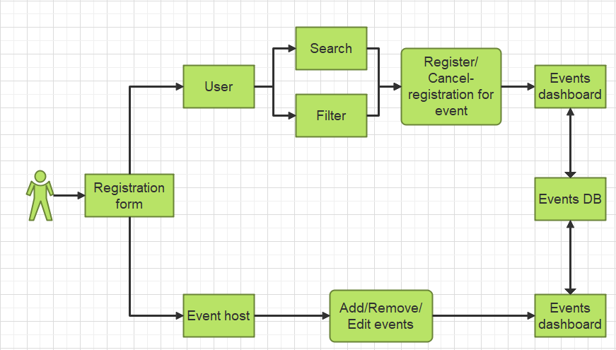
Process flow diagram

Slide 6
Modules
Frontend: JavaScript, HTML, CSS
Backend: Nodejs
DB: MongoDB

Slide 7
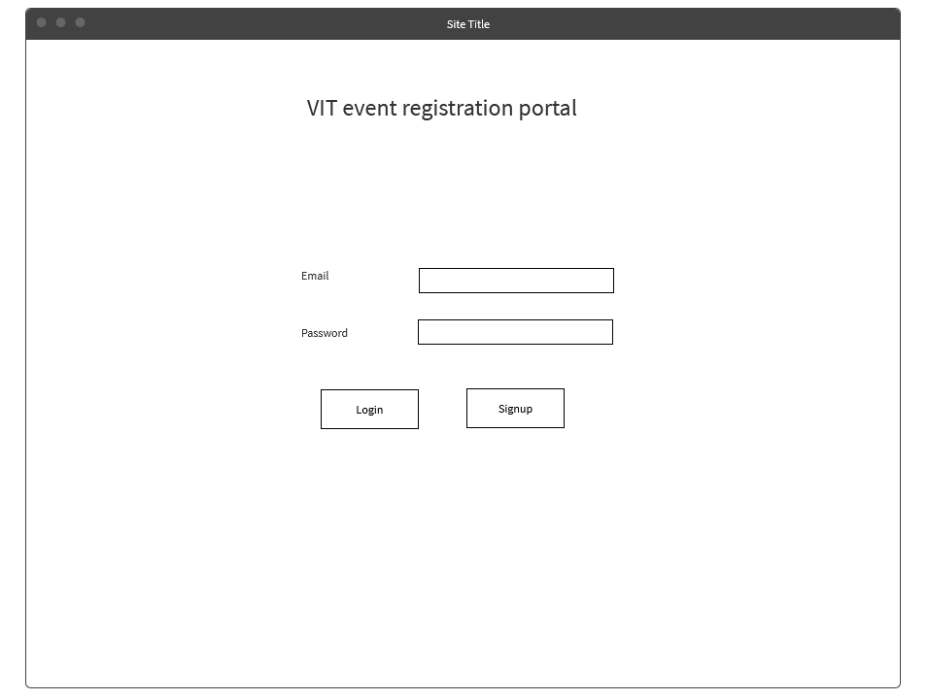
Prototype(login page)

